Slide 1

More about Rank

Slide 2


Rank
Rank R = Rank A
Maximum number of Independent Columns
$$=$$
3
Rank = ?
Number of Pivot Column
$$=$$
Number of Non-zero rows
Rank = ?
3
Notes:
Maximum number of Independent Columns = Number of Pivot Column
??????

Slide 3


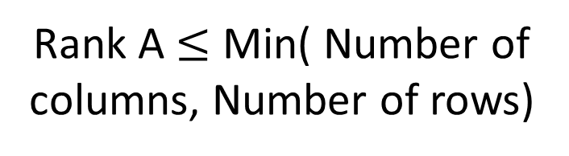
Rank
Maximum number of Independent Columns
Rank A $≤$ Number of columns
$$=$$
Number of Pivot Column
Rank A $≤$ Min( Number of columns, Number of rows)
$$=$$
Number of Non-zero rows
Rank A $≤$ Number of rows

Slide 4


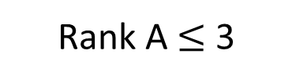

Rank
Matrix A is full rank
if Rank A = min(m,n)
Matrix A is rank deficient if Rank A < min(m,n)
Given a mxn matrix A:
Rank A $≤$ min(m, n)
Because “the columns of A are independent” is equivalent to “rank A = n”
If m < n, the columns of A is dependent.
$$\left[\begin{matrix}\begin{matrix}∗ & ∗\end{matrix} & \begin{matrix}∗ & ∗\end{matrix} \\ \begin{matrix}∗ & ∗\end{matrix} & \begin{matrix}∗ & ∗\end{matrix} \\ \begin{matrix}∗ & ∗\end{matrix} & \begin{matrix}∗ & ∗\end{matrix}\end{matrix}\right]$$
$$\left\{\left[\begin{matrix}∗ \\ ∗ \\ ∗\end{matrix}\right],\left[\begin{matrix}∗ \\ ∗ \\ ∗\end{matrix}\right],\left[\begin{matrix}∗ \\ ∗ \\ ∗\end{matrix}\right],\left[\begin{matrix}∗ \\ ∗ \\ ∗\end{matrix}\right]\right\}$$
3 X 4
A matrix set has 4 vectors belonging to R³ is dependent
Rank A $≤$ 3
In R^{m}, you cannot find more than m vectors that are independent.
Notes:
未看先猜
A is said to be rank deficient if it does not have full rank.

Slide 5
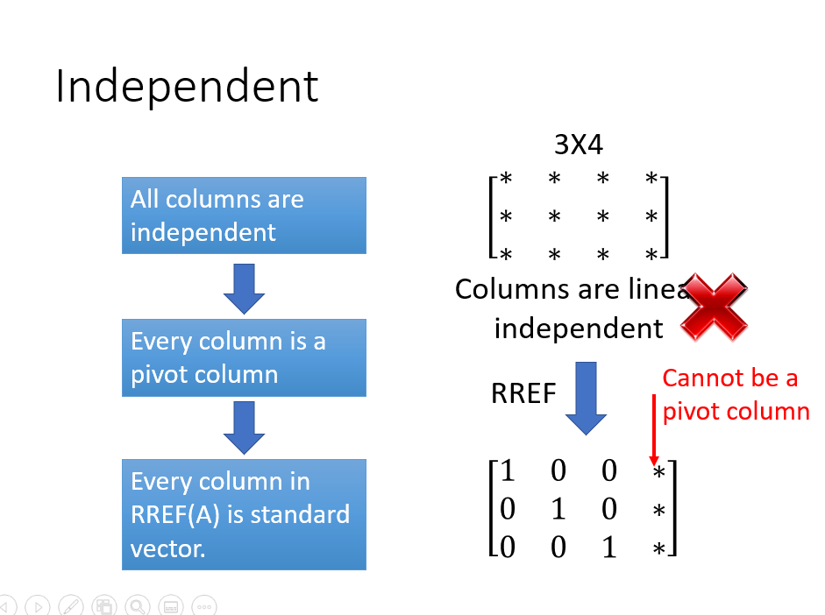

這個發現已經提過，現在只是用 Rank A $≤$ min(m, n) 再說一次

Slide 6


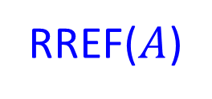


Basic, Free Variables v.s. Rank
3 useful
equations
$$Ax=b$$
$$A$$
$$b$$
RREF($A$)
$$b’$$
rank
=
non-zero row
=
3 basic variables
No. column –non-zero row
nullity
=
=
2 free variables
Notes:
The rank of [A b] is the number of “useful” equations in the system of linear equations Ax = b (i.e., the number of nonzero rows in [R c]).
The rank of A represents the number of basic variables while the nullity of A is the number of free variables.

Slide 7

Rank
Rank
Maximum number of Independent Columns
Number of Pivot Column
Number of Non-zero rows of RREF
Number of Basic Variables
Nullity = no. column - rank
Number of zero rows
of RREF
Number of Free Variables
Notes:
One of the statement is fake!!!!!!!!!!!!!!

